Slide 1

Loyalty Management Solution
Agenda
1-Introduction
2- Environment details (CRM and Portal)
3- External User Login and Registration
4- User Profile in portal
5- Entity tables & Product catalogue configuration,
6- ER Diagram.
7- Web Pages,Basic Forms,Views.
8- Create , Purchase Order, Product Line from Portal with different Product Categories and Card types
9- Bulk Insert from Portal for Create Orders.
10- Server jobs (Plugin, Business Rules, Power automate Flows)
11 –CRM Solution and portal configuration.

Slide 2
Environment Details
Below Environments have created for CRM and Portal
1- CRM - https://orge4eb3047.crm8.dynamics.com/
2- Power Portal - https://loyaltymanagementsol.powerappsportals.com/

Slide 3
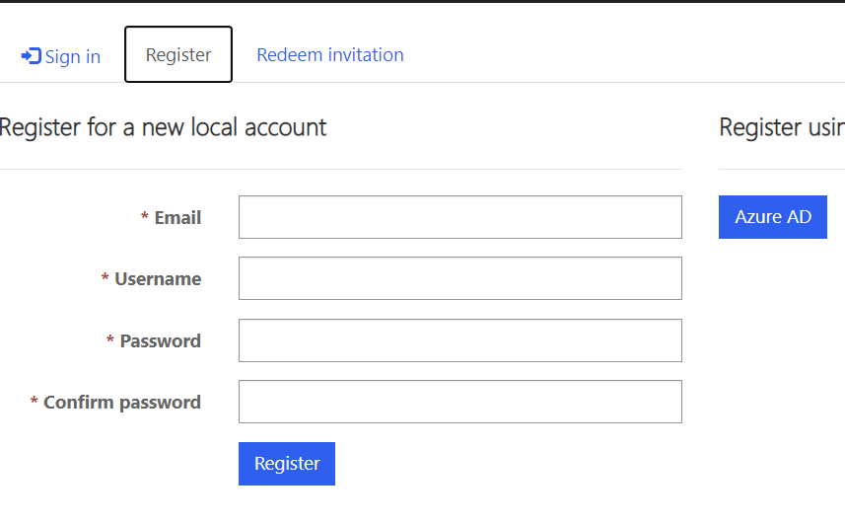
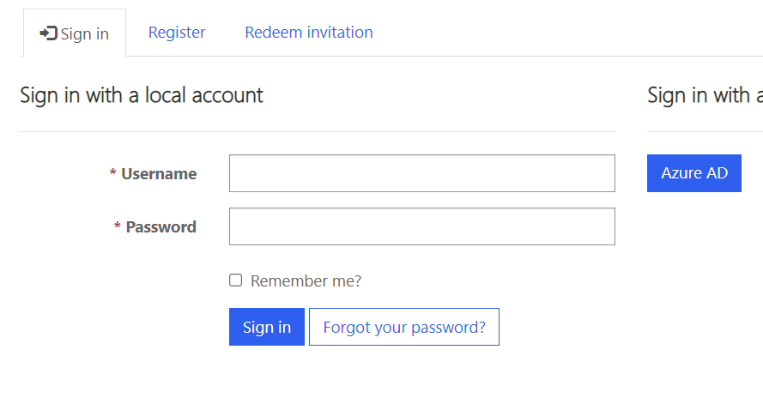
External user Login and Registration
1-New customer can register them portal form different method
2-Customer can register by different method of authentication
1- Local authentication
2- External Authentication – Microsoft Account, Facebook ,Twitter
3-User Can Register them by create contact and by using invitation method.

Slide 4
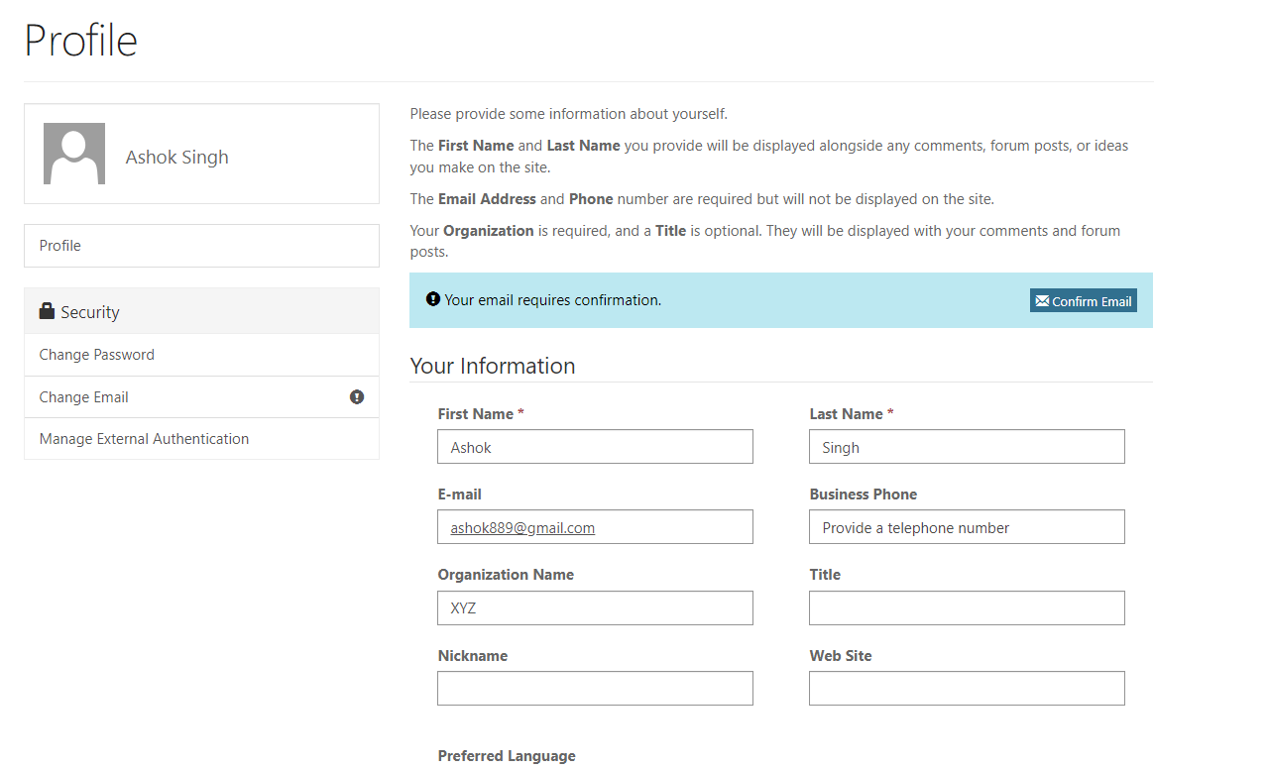
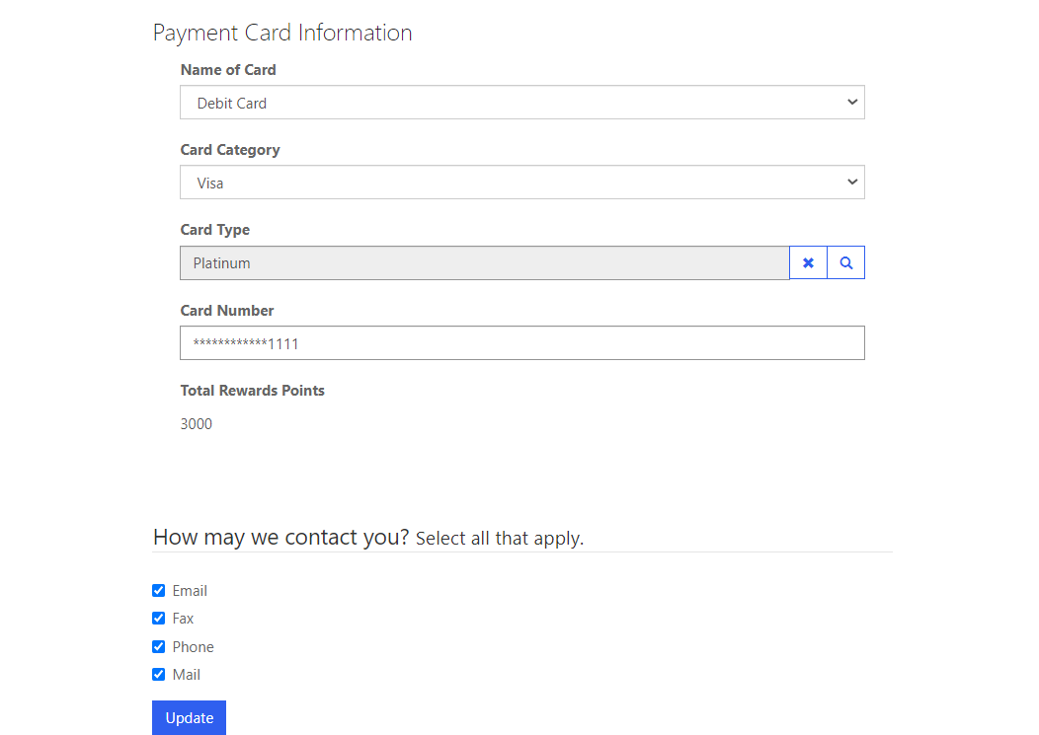
User Profile
After successful login in portal ,User can navigate and can see profile details look like below,
Payment Information ,accumulated reward points

Slide 5
Entity Table Configuration and ER Diagram
Below Tables have used for configure data in D365 CRM
1- Unit Group
2- Unit
3- Price List
4- Product
5- Price List Items
6- Product Category
7 – Order
8- Order Line
9- Card Type

Slide 6
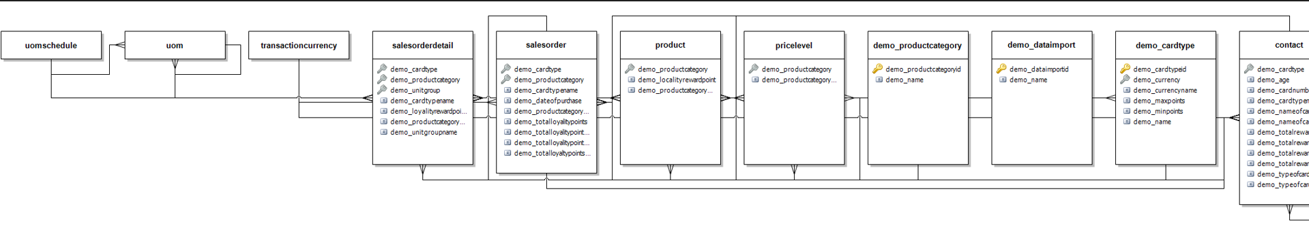
Entity Relationship Diagram

Slide 7
Web Pages ,Basic Form and Views
Web Pages
1- Purchase
2-Oder Detail
3-Data Import
Basic Forms
1- Purchase Order
2- Purchase Order - Edit
3-Data Import
4- Order Detail Create
5- Order Detail - Edit
List View
1- Purchase order view
2-Data Import
Web Roles
1- Administrator
2- Web Api User

Slide 8
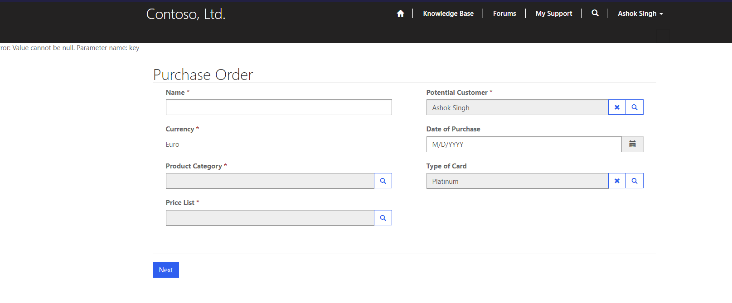
Create Purchase Order
Customer can login in to Portal and navigate for create purchase order show as below
User can fill below order form where customer and Card Type will autopopulate from user profile

Slide 9
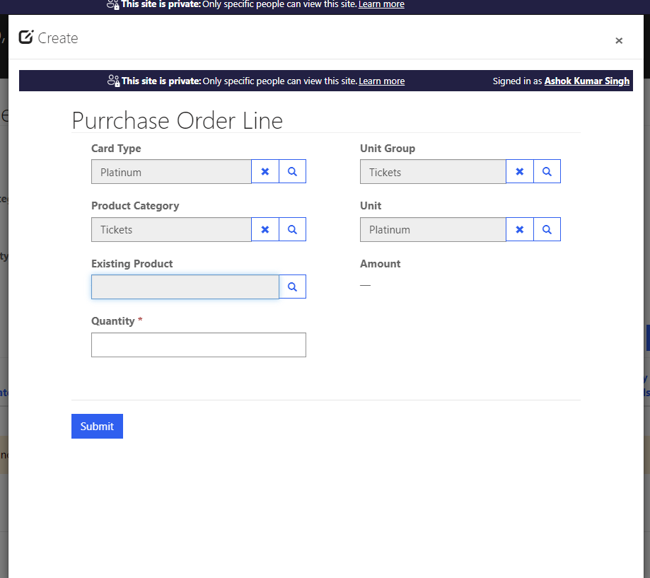
Create Purchase Order Detail
Customer can fill order detail with below detail

Slide 10
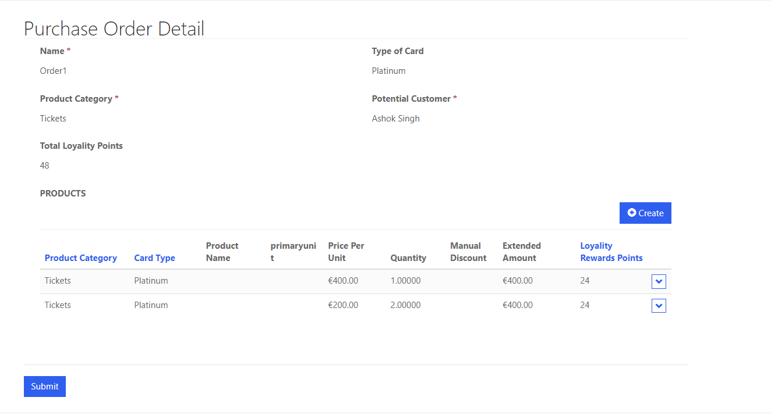
Create Purchase Order Detail
Once Order detail submit customer can see all details in subgrid

Slide 11
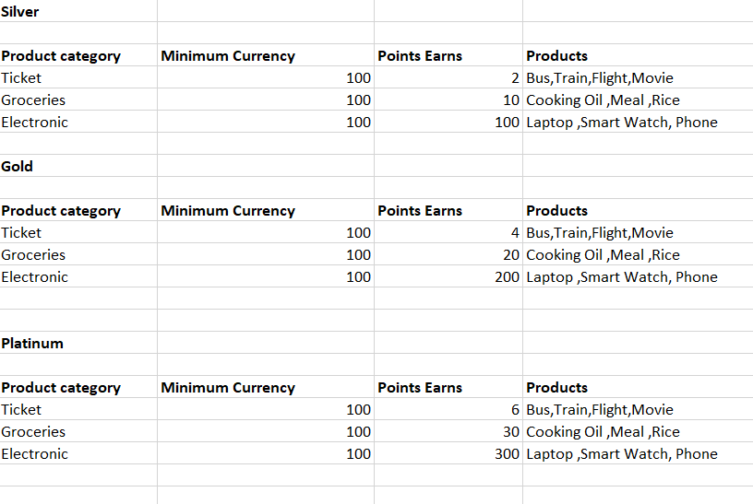
Points for different Products
Points used for different category cards

Slide 12
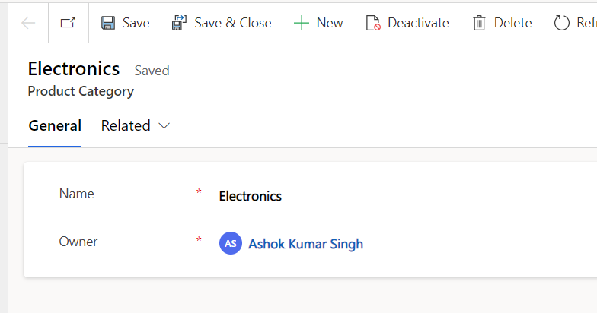
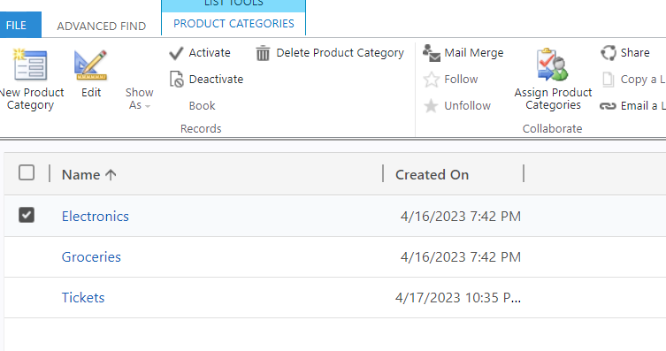
Product Category and Card Types form
Points used for different Product categories.

Slide 13
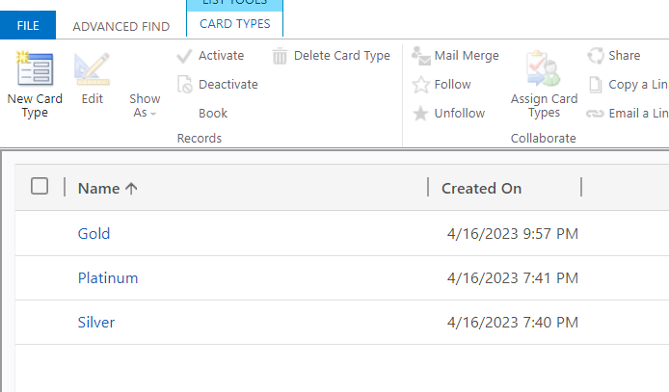
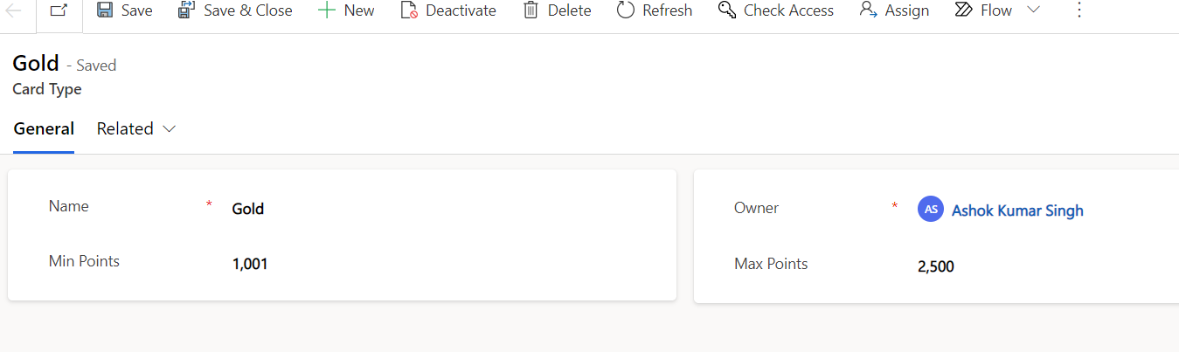
Product Category and Card Types form
Below card type will auto upgrade based on points

Slide 14
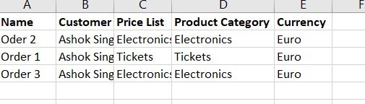
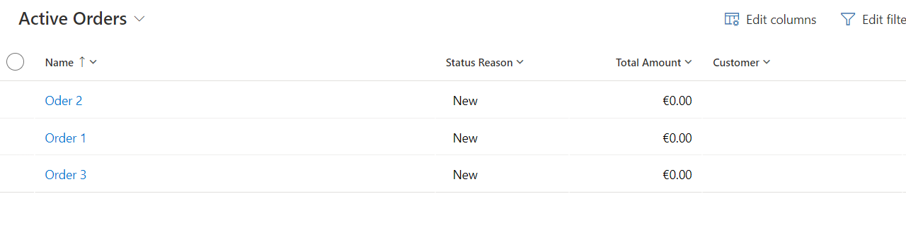
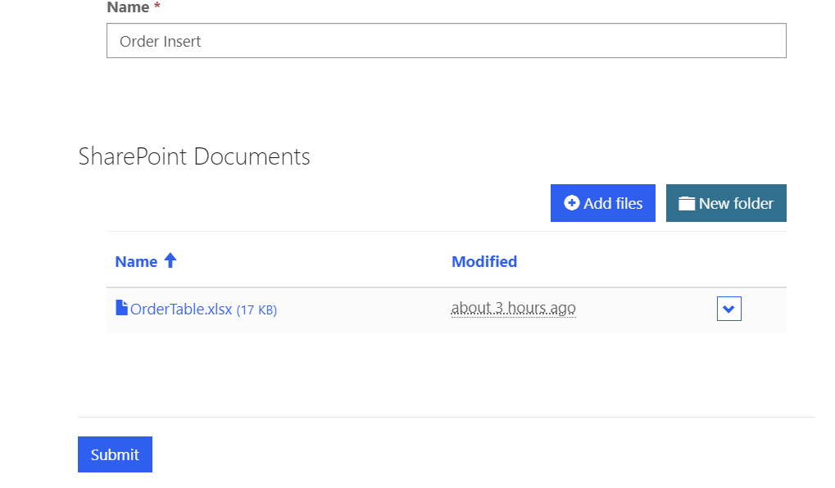
Bulk Insert Order from excel sheet
Customer can move to Data Import web Page and can create new or existing record for Data Import.
Customer can upload excel sheet of order data for import records
Once data sheet will get upload in SharePoint folder all records of sheet will available in Portal
CRM records bulk Insert.

Slide 15

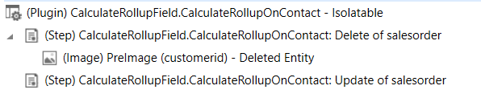
Plugins
Below Plugin steps used for auto calculate Reward points when new order line add in to order ,which trigger on update of loyalty reward point in order line.
Below Plugin steps used for auto calculate Reward points when new order add in to customer ,which trigger on update of Total reward point in order.
Note – Above plugins use for auto refresh rollup field which is available on Order and contact

Slide 16
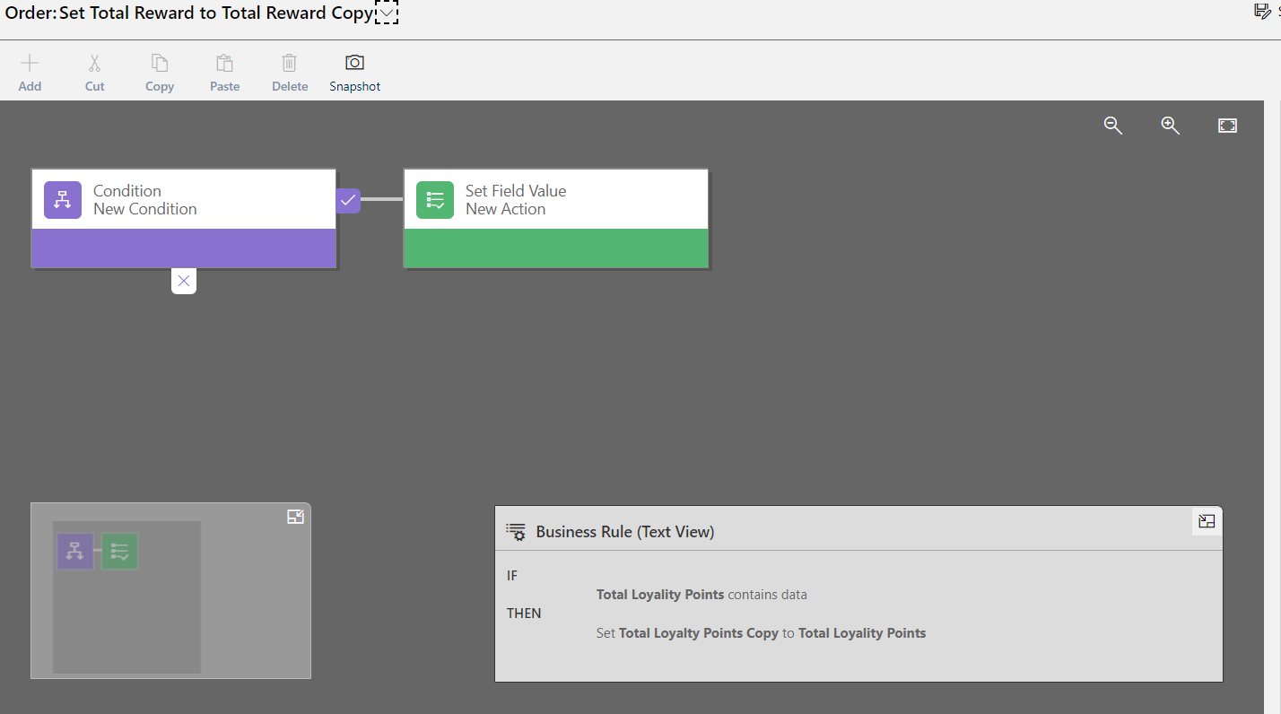
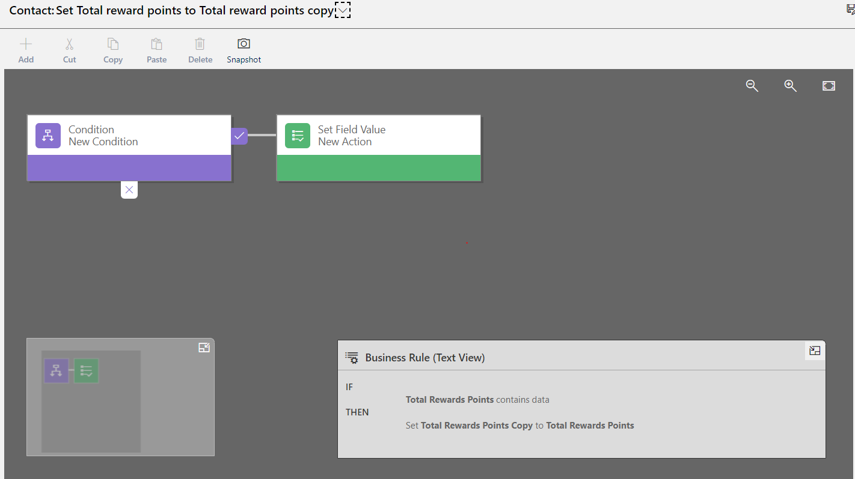
Business Rules
As we have limitation for rollup field we cant trigger power automate or plugin so we are using below field in order and contact for copying data from original roll up fields
Below business rules used on Order and Contact table.
Order
Contact

Slide 17
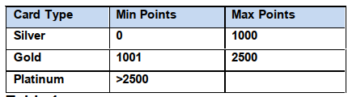
Power Automate Flows
Below Power automate flows used for backed jobs.
1- Order Line Create Flow - When Order Line create this flow will check Card Type and Product Category and based on its calculate total loyalty points for each order line.
2- Update Card Type Based on reward points- Flow will trigger when rewards point get update in Contact Profile , and update Card type based on below table.
2- Bulk Insert records from portal - Flow trigger when any excel file attach in portal and available in sharepoint ,its upload all data from SharePoint table to Dataverse.

Slide 18
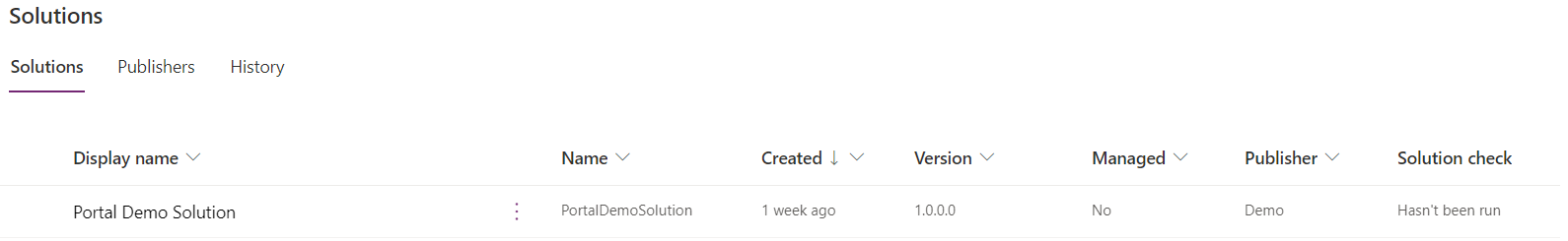
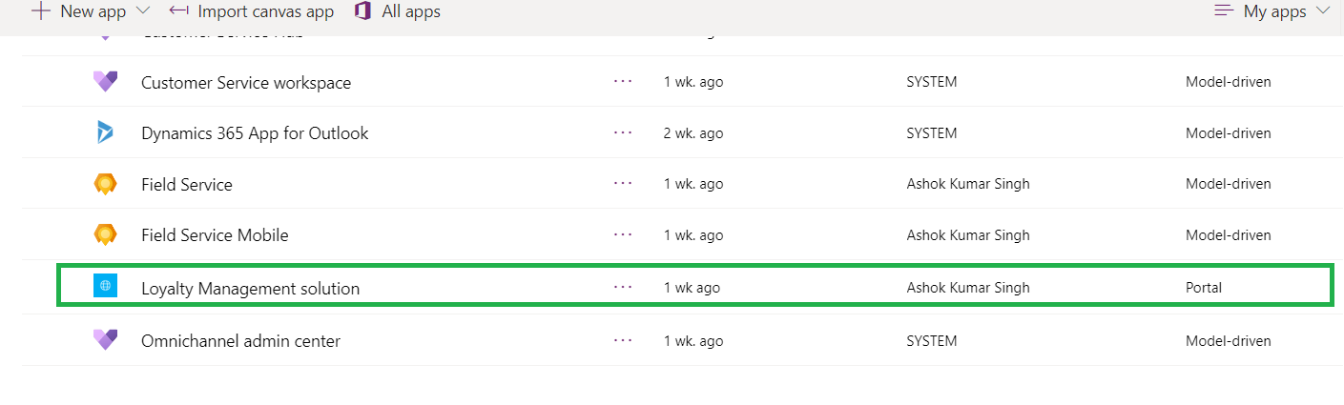
CRM Solution & Portal Configuration
Below CRM Solution available with all customization
1- Portal Demo Solution
2 – Portal App

Slide 19
Deployment Strategies
Below points need to keep in mind before deploy solution in upper environments
1- First need to deploy CRM solution using manually import or using CI/CD pipeline.
2- It will be good practice we use same guid for all master or Reference Data.
3- Deploy Portal configuration using Configuration Migration Tool or Portal records mover tool available in XRMToolBox.

Slide 20
Thank You!

